Slide 1
A Taste of XSEDE

Slide 2

XSEDE
XSEDE is a single virtual system that scientists can use to interactively share computing resources, data and expertise. People around the world use these resources and services — things like supercomputers, collections of data and new tools — to improve our planet.
Please go to https://www.xsede.org/ and register
After you register, send me your XSEDE ID so I can add you to our project

Slide 3
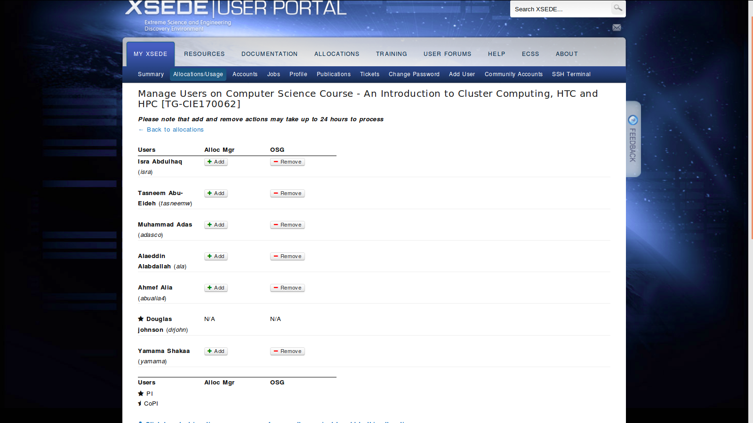

Slide 4
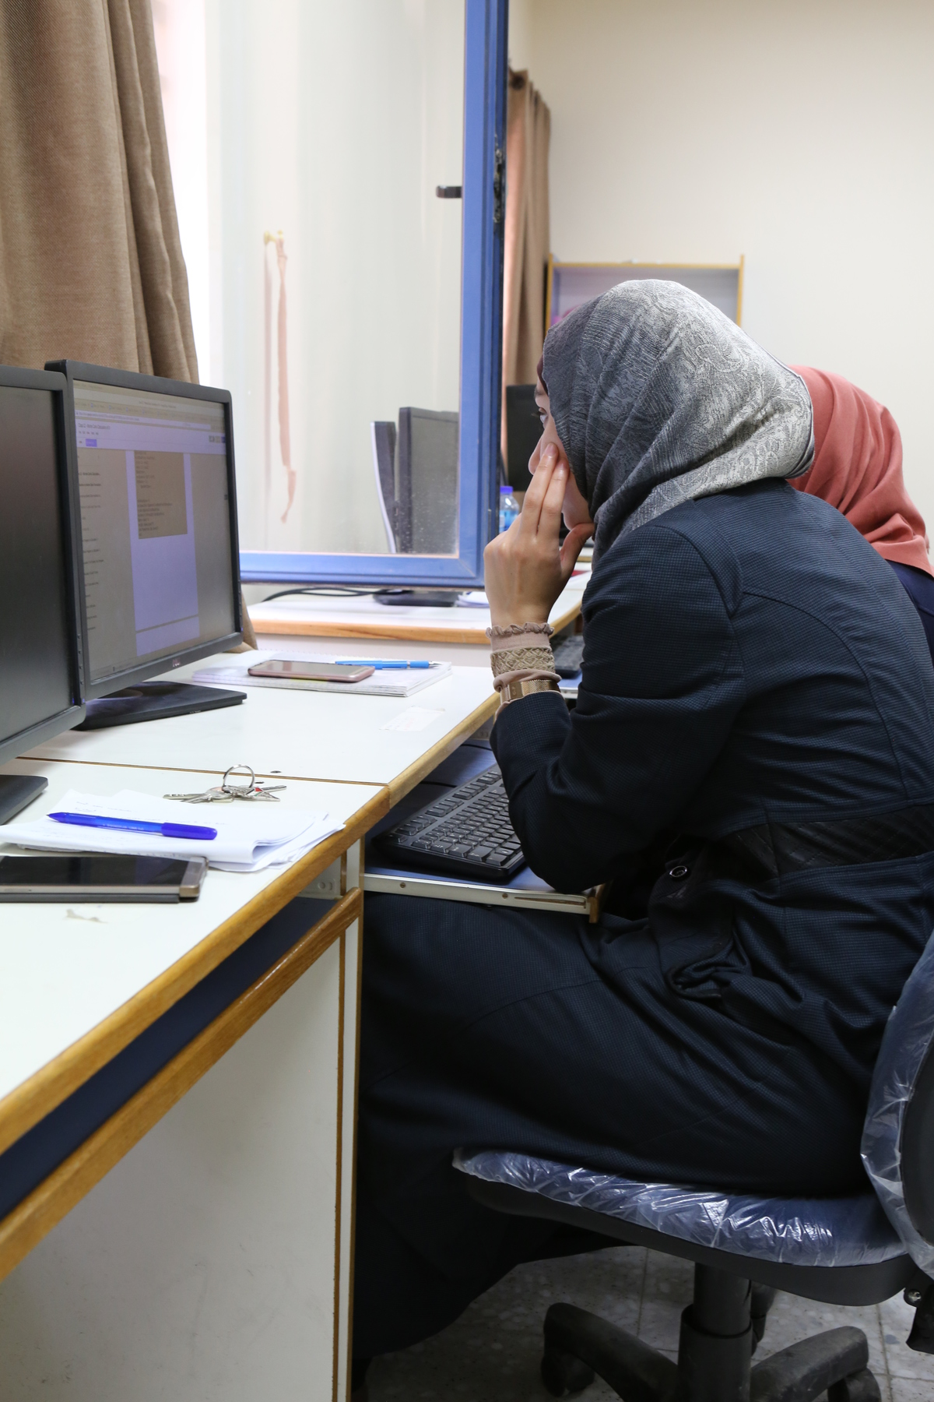
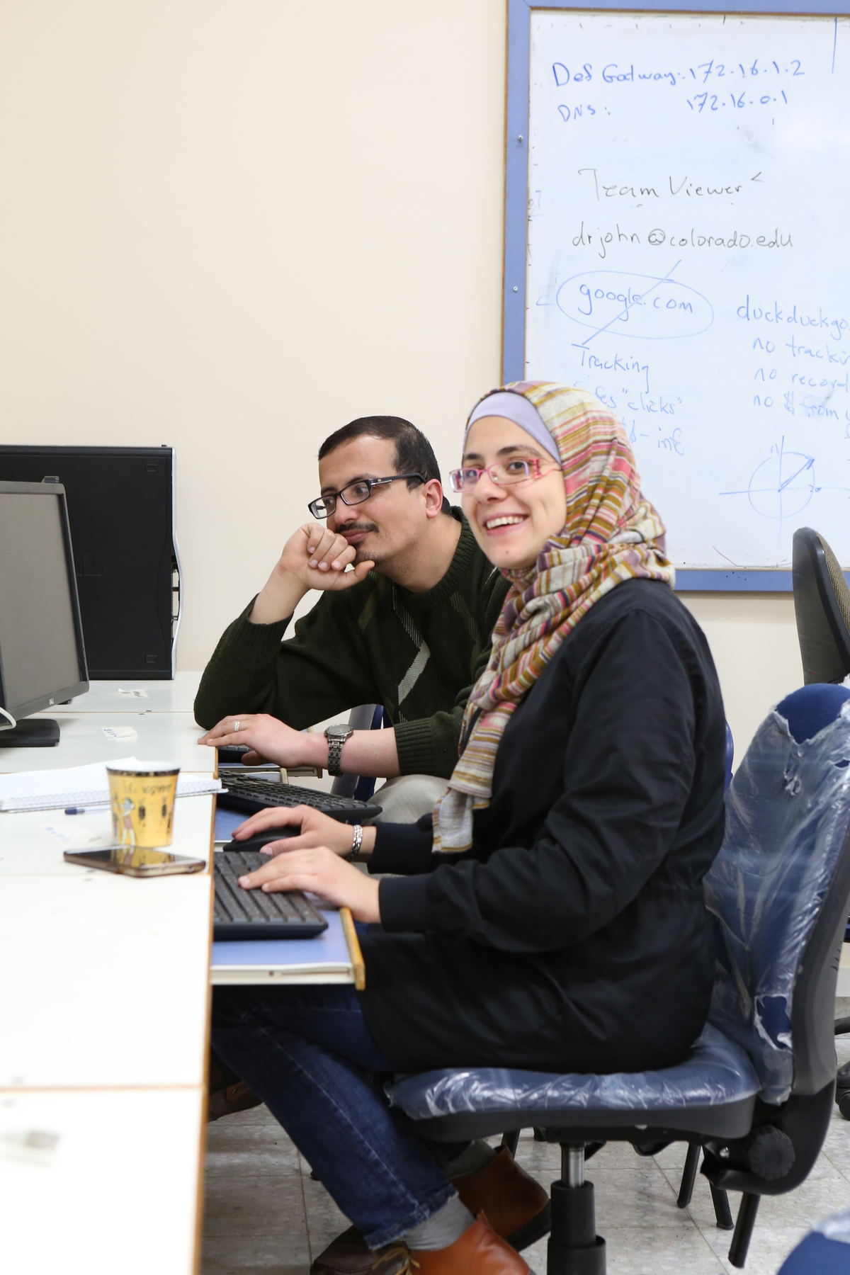
An Najah HTC Class
Spring 2018

Slide 5
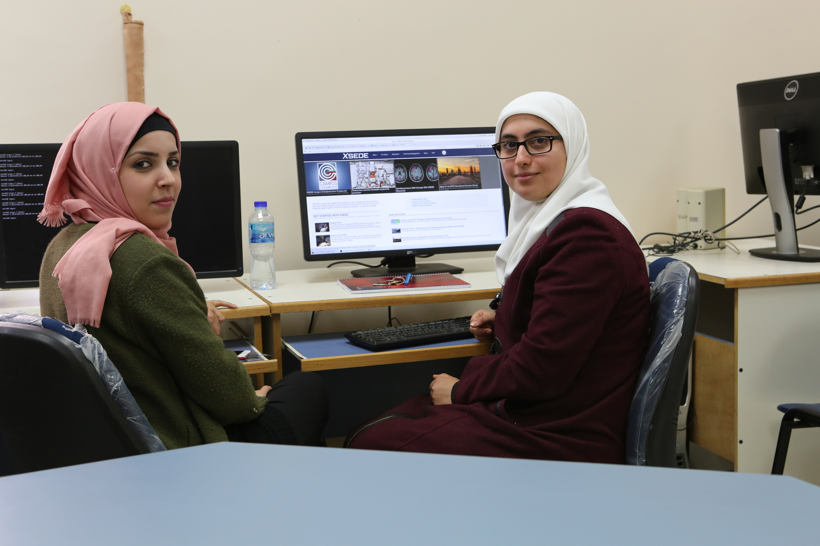
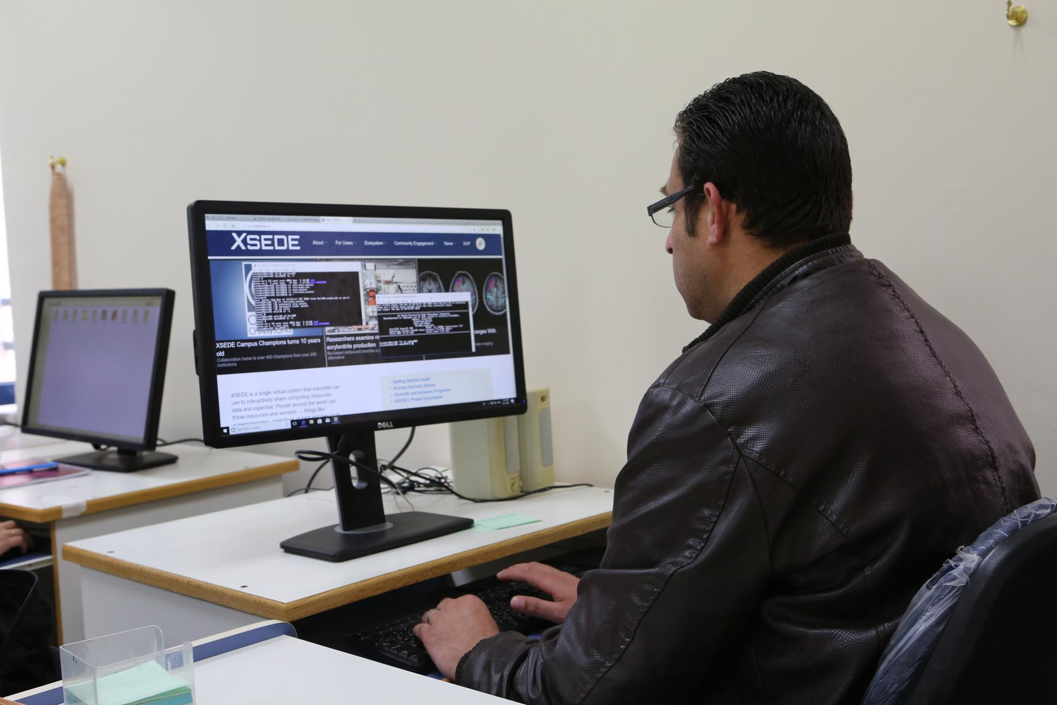
An Najah HTC Class
Spring 2018

Slide 6
For today
Today is a light day:
Try to finish the HTCondor (HelloWorld) from last class
Set up your XSEDE authentication
Run new versions of HelloWorld and CalcPi on XSEDE
Next week we start to tackle read problems:
NFS RAID File System
New Partitioning scheme for hard drives ⇒ Hadoop
Proxy Server for updates
User Accounts
System monitoring

Slide 7
Start thinking about a problem or topic you would like to study:
Population growth in Palestinian
Rise of plastic in the world’s oceans
Making a better fire alert system
Cuckoo search
Simulation or problem solving with matlab
Animation
Chemistry, biology, physics, networking simulation
Think big
Let’s talk
“Henry, For Chxxt Sake. I just want you to think big for once!”
Start thinking about the June full day workshop

Slide 8
Class 15 Agenda: A Taste of XSEDE
Date: April 19, 2018 Objective: Finish the previous HTCondor Tutorial Run your first jobs on XSEDE
Class 15 Slides: Class 15 -
In-class documentation: Class 15 - A Taste of XSEDE

